Slide 1
AGALYA.K FINAL PROJECT

Slide 2
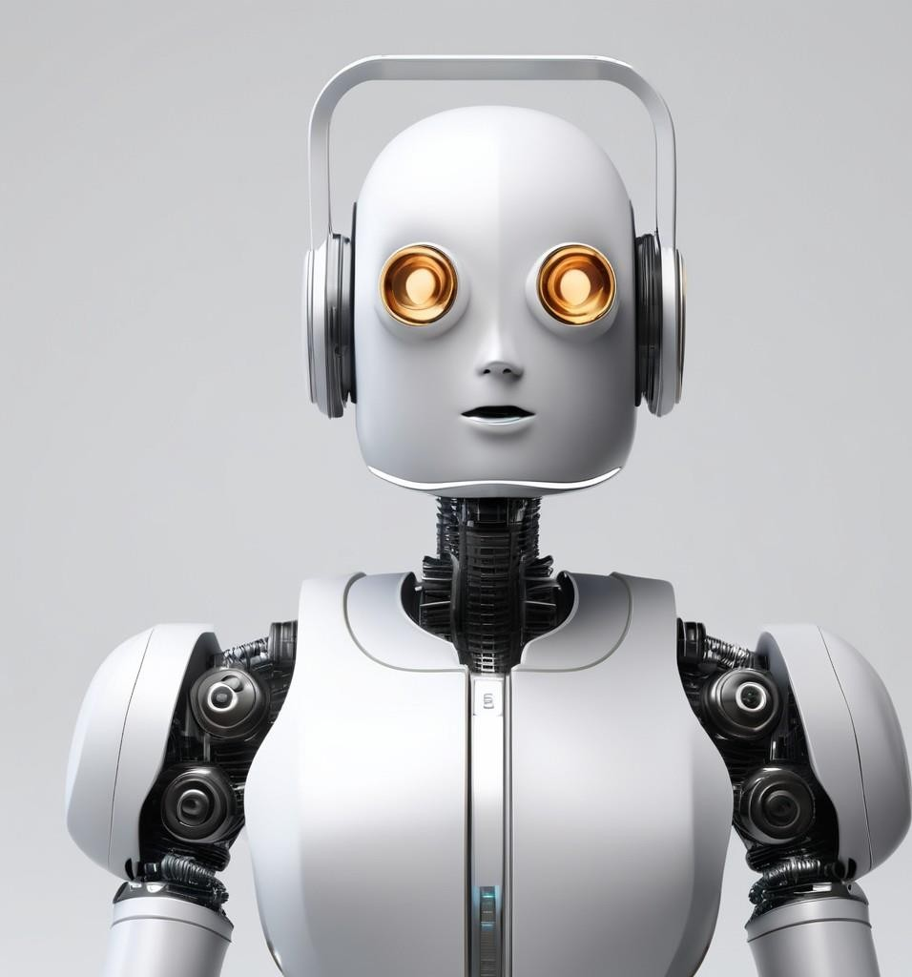
CHATBOT WITH RNN ALGORITHM

Slide 3

AGENDA
Problem Statement Project Overview End Users
Solution and Its Value Proposition
Best Thing in My Solution Modeling
Results

Slide 4
PROBLEM STATEMENT
▶Traditional chatbots often provide scripted responses, limiting engagement and personalization.
▶Businesses struggle to maintain meaningful interactions with customers due to the lack of conversational depth.
▶There is a need for chatbot solutions that can generate human-like responses, enhancing user experience and engagement.
▶The challenge lies in developing AI-driven chatbots capable of understanding context and generating coherent responses.
▶

Slide 5
PROJECT OVERVIEW
▶Introducing a Generative AI Chatbot to revolutionize customer interactions.
▶Leveraging advanced deep lIntroducing a Generative AI Chatbot to revolutionize customer interactions.
▶Leveraging advanced deep learning techniques to enable the chatbot to generate human-like responses.
▶Aim to enhance engagement and satisfaction by providing personalized and contextually relevant interactions.
▶Focus on creating a seamless and natural conversational experience for end users.

Slide 6
END USERS
TheEnd Users chatbot is designed to benefit a wide range of end users, including: Customers: Customers can use the chatbot to get quick and accurate responses to their inquiries, receive personalized recommendations, and make purchases without the need for human assistance.
Support Agents: Support agents can leverage the chatbot to automate routine tasks, such as answering frequently asked questions and providing basic troubleshooting guidance. This allows support agents to focus on more complex and critical customer issues.
Business Owners: Business owners can benefit from the chatbot by reducing customer service costs, improving response times, and enhancing overall customer satisfaction. The chatbot can also help gather valuable customer data and insights to inform business strategies and decision-making.

Slide 7
SOLUTION AND ITS VALUE PROPOSITION
The chatbot solution utilizes a state-of-the-art Recurrent Neural Network (RNN) algorithm to provide a seamless and personalized user experience. By leveraging the power of artificial intelligence, the chatbot offers a range of benefits to the end.
users:
24/7 Availability: The chatbot is available round the clock, allowing users to access
information and support at any time.
Instant Responses: With its advanced algorithm, the chatbot provides quick and accurate responses to user queries, eliminating the need for wait times.
Personalized Interactions: The chatbot is designed to understand user preferences and tailor its responses accordingly, creating a personalized and engaging experience.
Efficient Problem Solving: The chatbot can efficiently handle a wide range of tasks, from answering frequently asked questions to providing complex solutions, saving users time and
effort.
Continuous Improvement: The chatbot constantly learns from user interactions, improving its performance over time and ensuring a constantly evolving and enhanced user experience.

Slide 8
BEST THING IN MY SOLUTION
Unique Features:
Our chatbot utilizes an advanced RNN algorithm, allowing it to
understand and respond to user inputs more accurately and naturally.

Slide 9
MODELING
The chatbot utilizes a Recurrent Neural Network (RNN) algorithm for its natural language processing capabilities. The modeling process involves several techniques and algorithms to train the chatbot and enable it to generate appropriate responses based on user input.
Data Collection:
The first step in the modeling process is to collect a large dataset of conversations. This dataset
serves as the training data for the RNN algorithm.
Preprocessing:
Before training the RNN algorithm, the collected data undergoes preprocessing. This step involves
cleaning the data, removing irrelevant information, and transforming the text into a format suitable for training the model.
Word Embedding:
To represent words in a numerical format, word embedding techniques such as Word2Vec or GloVe
are used. These techniques map words to dense vectors in a continuous vector space, capturing semantic relationships between words.

Slide 10
.Training the RNN:
The preprocessed data and word embeddings are used to train the RNN algorithm. The RNN learns from the input-output pairs in the training data to generate appropriate responses based on user input.
Evaluation and Fine-tuning:
After training the RNN, the model is evaluated using various metrics to assess its performance.
If necessary, the model is fine-tuned by adjusting hyperparameters or retraining with additional data.
Deployment:
Once the model is trained and evaluated, it can be deployed as a chatbot application. The
chatbot interacts with users, processes their input, and generates relevant responses using the trained RNN algorithm.

Slide 11
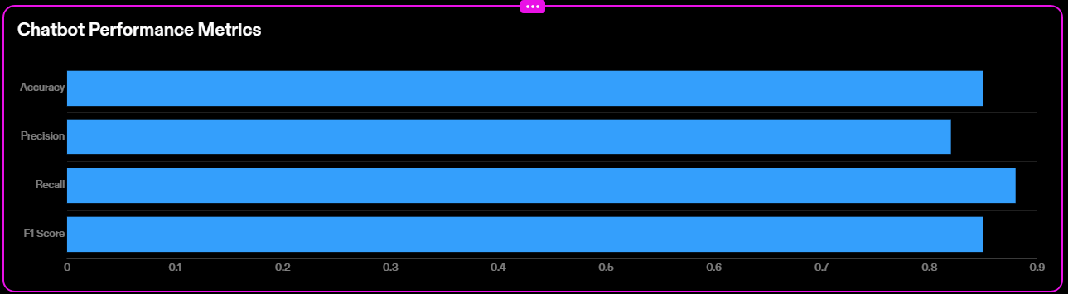

RESULTS
User Feedback
Users found the chatbot to be helpful and responsive.
Some users mentioned that the chatbot could improve in understanding
complex queries.

